Slide 1

Problem Solving using Python
Programming
(24CSE0101)
Department of Computer Science and Engineering
CUIET, Chitkara University, Punjab

Slide 2

Python – Nested Loop
≈ Nested loops are a fundamental concept used to handle tasks that require repetition within repetition.
≈ If a loop exists inside the body of another loop, it is called a nested loop.
≈ Loops are referred to as outer loop and inner loop.
≈ The outer loop controls the number of execution of the inner loop/s.

Slide 3
Python – Nested Loop
≈ The inner or outer loop can be any type, such as a while loop or for loop.
≈ The outer loop can contain more than one inner loop.
≈ There is no limitation on the chaining of loops.
≈ In each iteration of the outer loop inner loop execute all its iteration.
≈ Nested loops are typically used for working with multidimensional data structures, such as 2-D arrays, iterating a sequence such as a list, string, tuple and range.

Slide 4
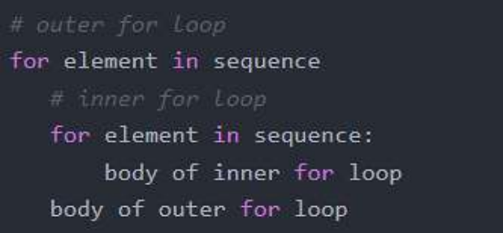
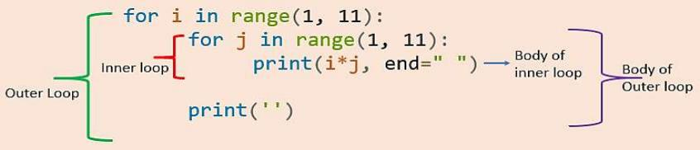
Python – Nested Loop
Syntax of using a nested for loop in Python:
For example;

Slide 5
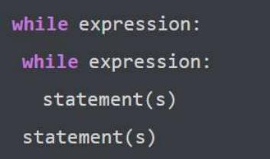
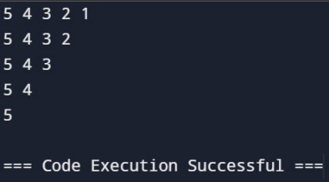
Python – Nested Loop
Syntax of nested while loop in Python:
For example;
i = 1 while(i <= 5): j = 5 while(j > i-1): print(j, end=' ') j = j - 1 i = i + 1 print()
Output;

Slide 6
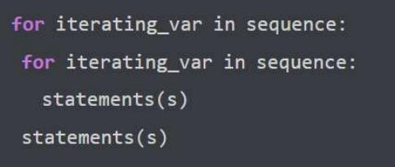
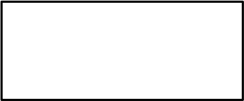
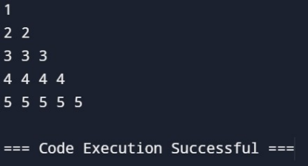
Python – Nested Loop
Syntax of nested for loop in Python:
For example;
Output;
for i in range(1, 6):
for j in range(i):
print(i, end=' ')
print()

Slide 7

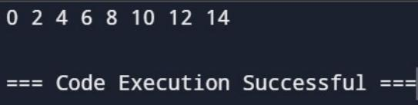
Python – Nested Loop
≈ The two for and while loop constructs can also be mixed in a nested loop construct.
For example;
i = 0
for n in range(1,15):
while i <= n:
print (i, end = ' ')
i = i + 2
print()
Output;

Slide 8
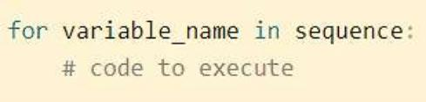
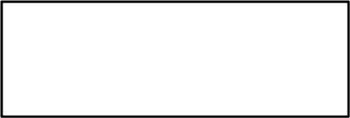
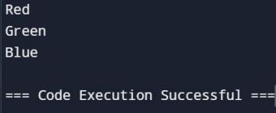
Python – For Loop
≈ Loops are essential in programming to the extent that they allow for efficient and flexible code repetition.
≈ In Python, the for loop is used for iterating over sequence types such as list, tuple, set, range, etc.
For example;
Output;
colors = ['Red', 'Green', 'Blue']
for x in colors:
print(x)

Slide 9
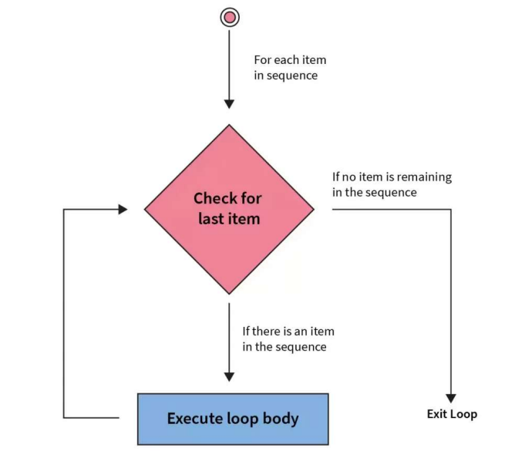
Python – For Loop

Slide 10

Looping through Strings with For loop
≈ You can iterate through each character in a string in Python by using a for loop.
For example;
language = "PYTHON" # Iterate over each character in the string for character in language: print(character)
Output:

Slide 11
For Loop with range () function
≈ When a for loop is used, a range of sequence is specified (only once).
≈ Python has a built-in method called range() that returns a list of numbers.
≈ Developers frequently use it with for loops to iterate over a list of numbers repeatedly.
≈ The range() function returns a sequence of numbers; starting point, ending point and increment number.

Slide 12
For Loop with range () function
Syntax of range: range(start, stop, step)
Parameter | Description
Start (optional) | An integer no. specifying position to start. By default it is 0.
Stop (required) | An integer no. specifying position to stop.
Step (optional | An integer no. specifying the increment. By default it is 1.

Slide 13
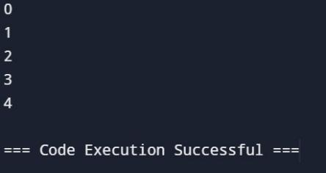
For Loop with range () function
Python range (stop):
For example;
Output;
# Iterate through a sequence of numbers for i in range(5): # Print each number print(i)

Slide 14
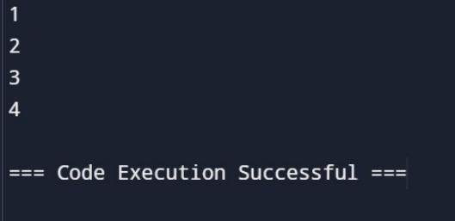
For Loop with range () function
Python range (start, stop):
For example;
Output;
# Iterate through a sequence of numbers for i in range(1,5): # Print each number print(i)

Slide 15
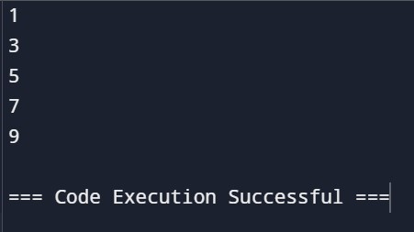
For Loop with range () function
Python range (start, stop, step):
For example;
# Iterate through a sequence of numbers for i in range(1,10,2): # Print each number print(i)
Output:

Slide 16
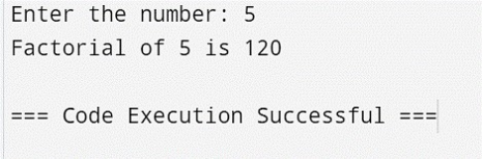
For Loop with range () function
Example;
#Write a program using for loop to calculate factorial of number. num = int(input("Enter the number: ")) if(num == 0): fact = 1 fact = 1 for i in range(1,num+1): fact = fact*i print("Factorial of", num, "is", fact)
Output:

Slide 17
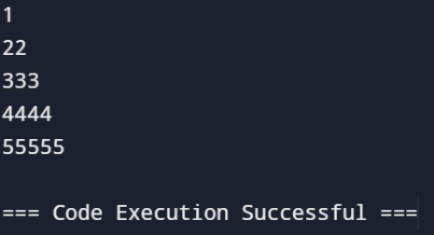
Nested For Loop
≈ The for loop with one or more inner for loops is called nested for loop.
For example;
for i in range(1, 6): for j in range(i): print(i, end='') print('')
Output:

Slide 18
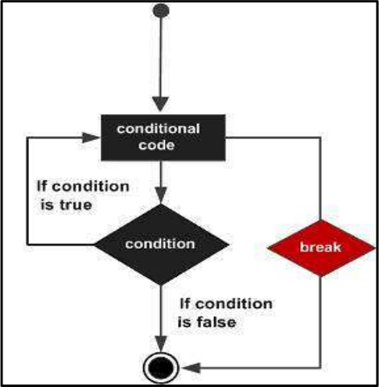
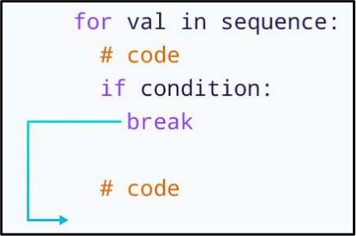
Python – Break statement
≈ Break statement is used to terminate the
current loop and resumes execution at the next statement.

Slide 19
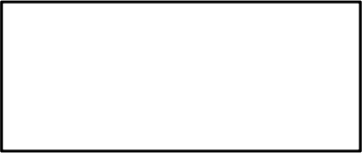
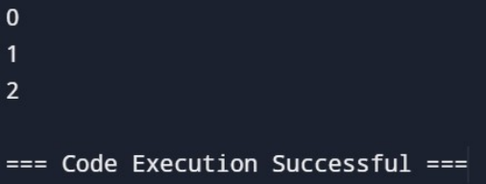
Python – Break statement
For example;
for i in range(5):
if i == 3:
break print(i)
Output:

Slide 20
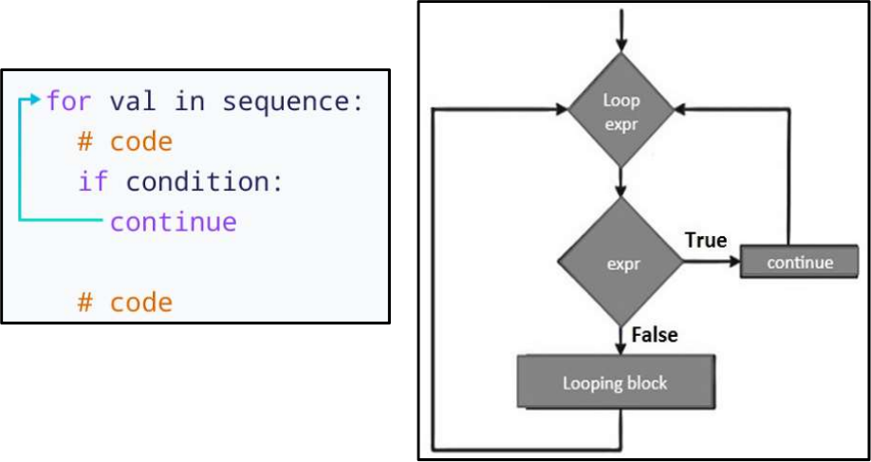
Python – Continue statement
≈ Continue statement skips the current iteration of the loop and control flow goes to the next iteration.

Slide 21
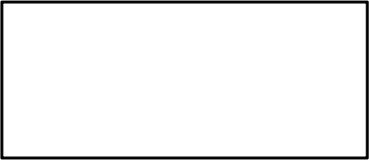
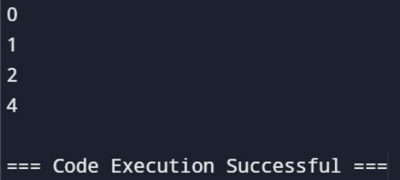
Python – Continue statement
For example;
for i in range(5):
if i == 3:
continue print(i)
Output:

Slide 22
Python – Pass statement
≈ Pass statement is used as a placeholder for future code.
≈ When the pass statement is executed, nothing happens. ≈ It results in no operation (NOP).
≈ Because, empty code is not allowed in loops, function definitions, class definitions, or in if statements.
The difference between Comment and Pass statement is that interpreter ignores a comment entirely, but pass is not ignored.

Slide 23
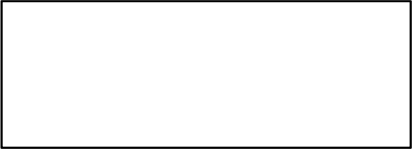
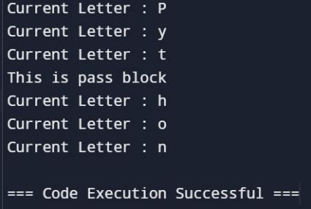
Python – Pass statement
_{For} _{example;} for letter in 'Python':
if letter == 'h':
pass
print ('This is pass block')
print ('Current Letter :', letter)
Output:

Slide 24
Python – Pattern Design
≈ Pattern printing in Python is a common programming exercise that helps develop logical and coding skills.
≈ These patterns are often used for aesthetic purposes and in educational contexts to enhance programming skills.
≈ The multiple loops are used to print the patterns where the first outer loop is used to print the number of rows, and the inner loop is used to print the number of columns.

Slide 25
Python - Pattern Design
GeneraI Steps to Print Patterns in Python:
≈ Determine the Pattern: Decide the type of Pattern you want
to print, such as pyramids, stars, numbers, or letters.
≈ ldentify the Pattern RuIes: Analyse the pattern, includes the
number of rows/characters to be printed, and their positions.
≈ Use Nested Loops: to control the row and column positions within the pattern programs.
≈ AppIy ConditionaI Statements: if statements can be used to decide whether to print a character or whitespace at a particular position.
≈ Print the Pattern: Use print function to display the characters or spaces within the nested loops.

Slide 26
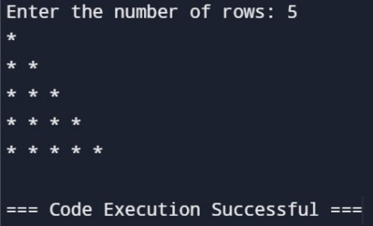
Python – Pattern Design
Pattern - 1: Right angle triangle pyramid
Example;
n = int(input("Enter the number of rows: ")) for i in range(0, n): for j in range(0, i+1): print("* ", end="") print()
Output:

Slide 27
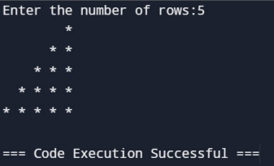
Python – Pattern Design
Pattern - 2: Reverse right angle triangle pyramid
rows = int(input("Enter the number of rows:")) k = 2* rows-2 for i in range(0, rows): for j in range(0, k): print(end=" ") k = k - 2 for j in range(0, i + 1): print("* ", end="") print('')
Example;
Output:

Slide 28
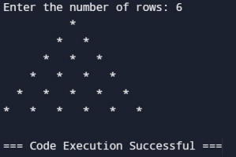
Python – Pattern Design
Pattern - 3: Simple triangle pyramid
rows = int(input("Enter the number of rows: ")) k = 2 * rows-2 for i in range(0, rows): for j in range(0, k): print(end=" ") k = k-2 for j in range(0, i+1): print("* ", end=" ") print()
Example;
Output:

Slide 29
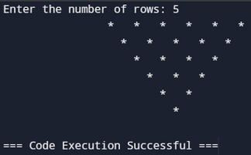
Python – Pattern Design
Pattern - 3: Simple reverse triangle pyramid
rows = int(input("Enter the number of rows: ")) k = 2 * rows-2 for i in range(rows, -1, -1): for j in range(k, 0, -1): print(end=" ") k = k+1 for j in range(0, i+1): print("* ", end=" ") print()
Example;
Output:

Slide 30

Python – Pattern Design
Pattern - 4: Diamond shaped pyramid
rows = int(input("Enter the number of rows: ")) k = 2 * rows - 2
for i in range(0, rows):
for j in range(0, k):
print(end=" ")
k = k - 1
for j in range(0, i + 1):
print("* ", end="")
print()
k = rows - 2
for i in range(rows, -1, -1):
for j in range(k, 0, -1):
print(end=" ")
k = k + 1
for j in range(0, i + 1):
print("* ", end="")
print()
Example;

Slide 31
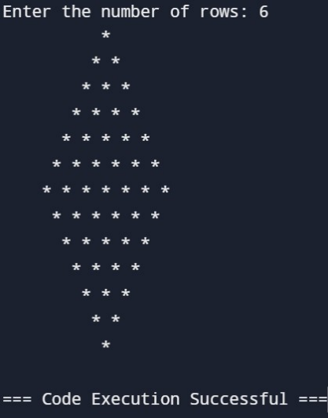
Python – Pattern Design
Pattern - 4: Diamond shaped pyramid
Output:

Slide 32

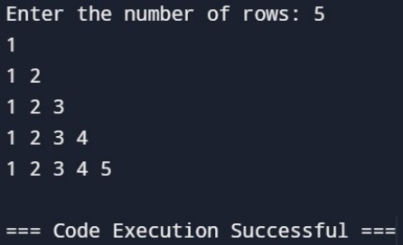
Python – Pattern Design
Pattern - 1: Number Pattern
n = int(input("Enter the number of rows: ")) for i in range(n):
for j in range(i+1):
print(j+1, end=" ")
print()
Example;
Output:

Slide 33
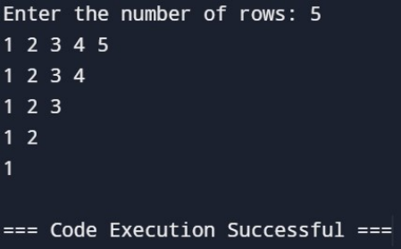
Python – Pattern Design
Pattern - 2: Inverted Number Pattern
n = int(input("Enter the number of rows: ")) for i in range(n):
for j in range(n-i):
print(j+1, end=" ")
print()
Example;
Output:

Slide 34
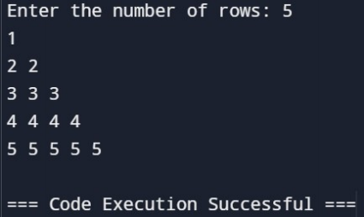
Python – Pattern Design
Pattern - 3: Descending order Number Pattern
n = int(input("Enter the number of rows: ")) for i in range(1,n+1): m = i for j in range(1, i+1): print(m, end=" ") print()
Example;
Output:

Slide 35
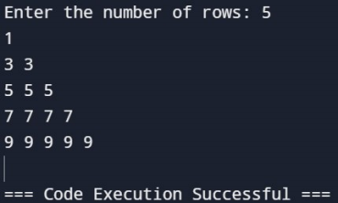
Python – Pattern Design
Pattern - 4: Ascending order Number Pattern
rows = int(input("Enter the number of rows: ")) i = 1 while i <= rows: j = 1 while j <= i: print((i * 2 - 1), end=" ") j = j + 1 i = i + 1 print()
Example;
Output:

Slide 36


